Slide 1
unpermitted fence removed from carbon-la costa beach
Mountains Recreation and Conservation Authority
May 12, 2021
Notes:
Good afternoon, Chair, Commissioners, staff and members of the public. Mario Sandoval, Project Manager for the Mountains Recreation & Conservation Authority (MRCA), the property manager for the Santa Monica Mountains Conservancy. We are before you to report the removal of an unpermitted fence from SMMC's property at Carbon-La Costa Beach.

Slide 2
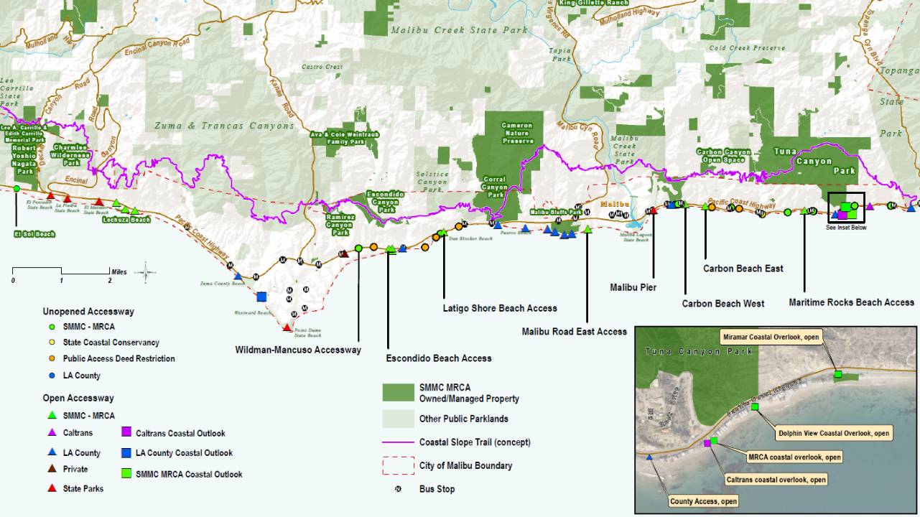
Carbon – La Costa Beach
Notes:
This map shows the regional location of Carbon-La Costa Beach. Note that the Carbon-La Costa Beach property is served by two bus stops. The property does not have any public access improvements yet; public access improvements are proposed in the forthcoming Malibu Access Public Works Plan, under development by the Coastal Conservancy and the MRCA.

Slide 3
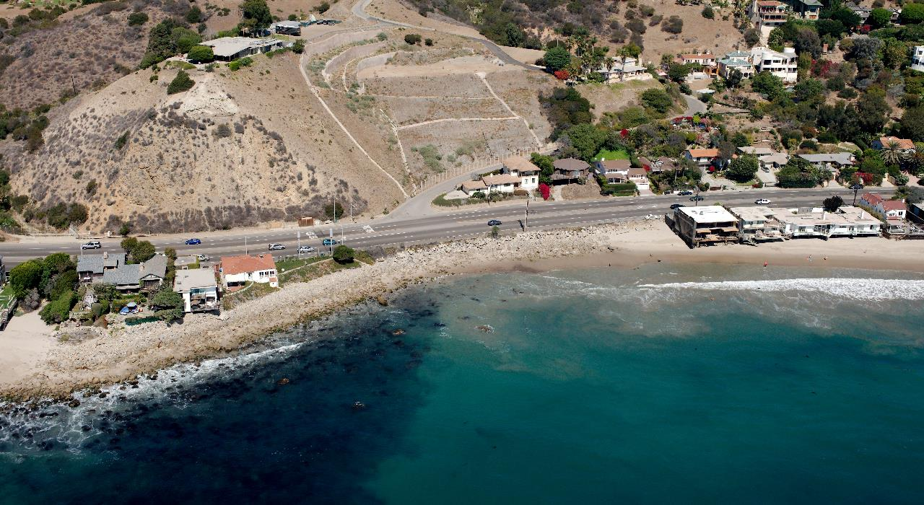
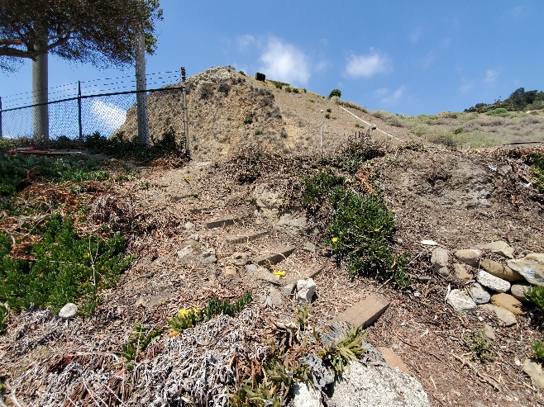
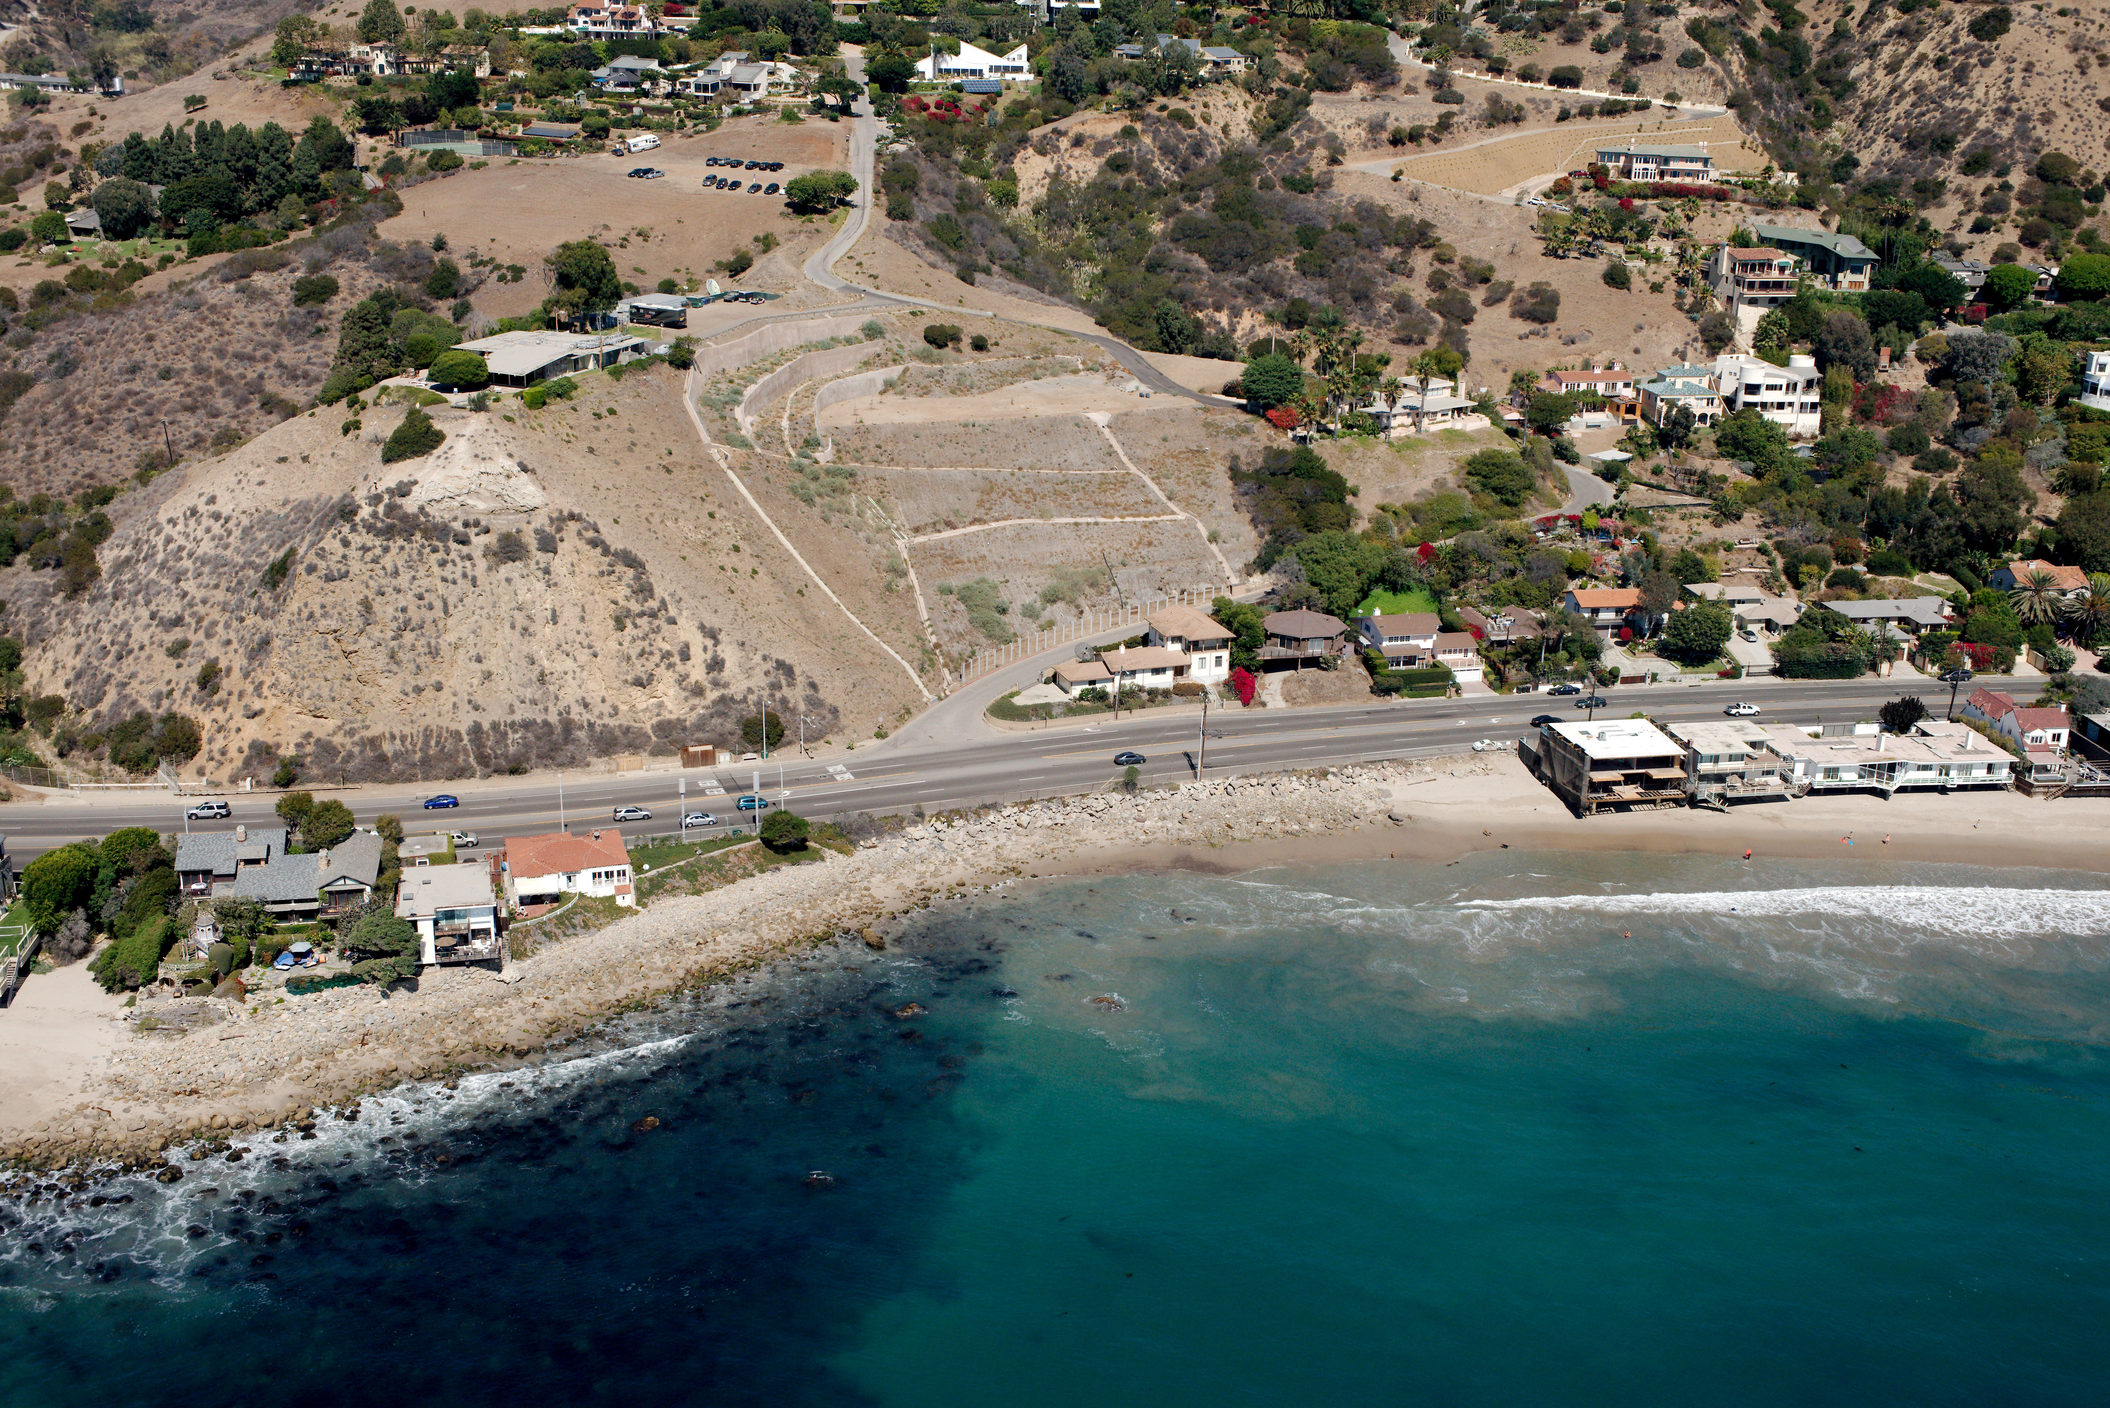
Carbon – la costa public acquisition
Notes:
A short summary of this property's important history. In 1999, the Coastal Commission required the dedication of the eastern parcel to mitigate public coastal view impacts from 3 new residential developments on Carbon Beach; the dedicated parcel was accepted by the Coastal Conservancy. In 2003, the Coastal Conservancy acquired the western parcel for fair market value which was over one million dollars. The neighbors sued the Coastal Conservancy and the case was settled with the agreement that before any public access management plan and/or site plan for improvements is approved, the homeowner-plaintiffs will have the opportunity to review the management plan and/or site plan for improvements. In 2018, the property was transferred to the Santa Monica Mountains Conservancy.
The two parcels are referred to as Carbon-La Costa Beach property because they span Carbon Beach to the west and La Costa Beach to the east. Please note that the western neighbor has a stairway encroachment on the SMMC's western property as shown in the red circle.

Slide 4
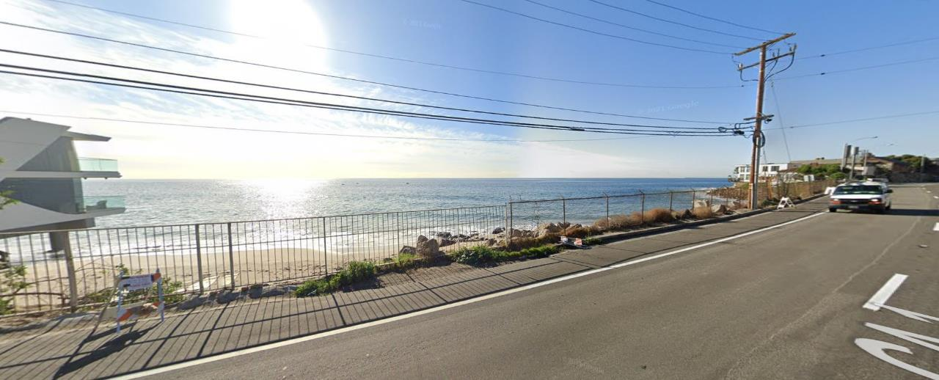
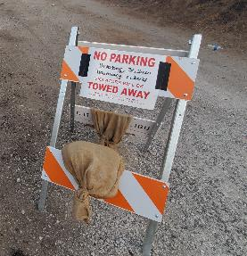
Carbon – la costa beach previous fence
Google Street View (Image date: December 2020)
Notes:
You can see the pre-existing fence better here. When the Carbon-La Costa property was publicly acquired, there was an existing fence. You can see that the dedicated parcel had one type of fence; the purchased parcel had another fence type. This image is from December 2020; in the red circle, you can see one of MRCA's fence repairs made during the pandemic. As every coastal manager knows, beach visitorship during the pandemic is exceptionally high with a lot of public pressure to get to the beach, like the Carbon-La Costa property.
We also draw your attention to the "No Parking" signs that the City of Malibu placed here without a coastal development permit. After your staff opened a violation, the City finally removed those signs in February 2021.

Slide 5
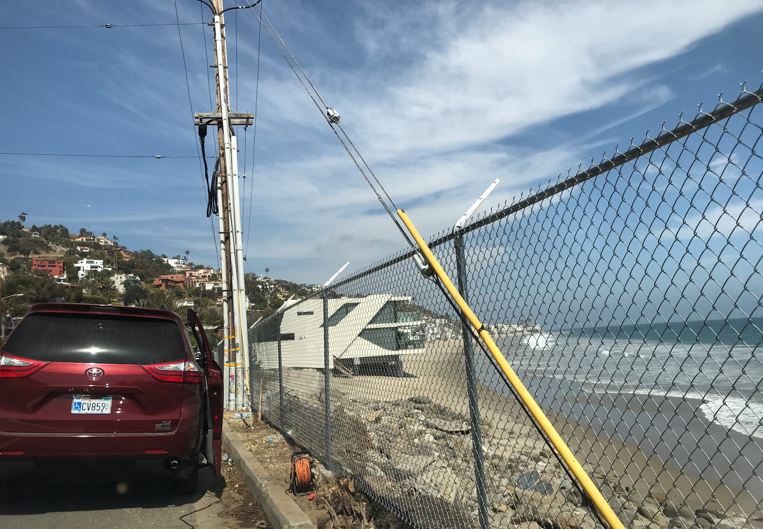
Carbon-La Costa Beach offers important coastal access
Notes:
The removal of the City's "No Parking" signs was significant because even without beach access, the Carbon-La Costa property is well-used as a place to park and enjoy the spectacular coastal view, especially by people in vehicles with disabled parking placards. This is a commonly observed use.

Slide 6
Neighbor Communication chronology
August 3, 2020 – Doug Rogers (eastern residential neighbor) emails City of Malibu about the aesthetic condition of and a hole in the fence. City forwards complaint to Coastal Commission staff; CCC staff forwards to MRCA.
August 6, 2020 - MRCA emails Rogers of August 4th fence repair and requests Rogers contact MRCA Ranger Services/LA County Sheriff to report future incidents.
August 6, 2020 - Rogers emails City complaining about MRCA's repair work.
September 8, 2020 - Rogers emails CCC staff that fence damaged during Labor Day; 100s of people on beach; neighbors repair fence; and suggests "fence with spikes at the top" to keep people out.
September 8, 2020 - MRCA emails Rogers re fence repairs ASAP; advises CDP needed for replacement fence; and reiterates Rogers/neighbors contact MRCA Ranger Services/LA County Sheriff in lieu of "self-help."
May 5, 2021 – MRCA observes old fence removed; new fence under construction; asks contractor crew about permits, landowner permission and contractor's employer.
May 7, 2021 - MRCA Rangers interview contractor who calls employer (neighbors); neighbors admit removing old fence and building new fence alleging City permission and refuse to remove new fence. MRCA removes unpermitted new fence.
Notes:
With the pre-existing old fence, public access was limited to visual access only although our observations show that the residents used this publicly-owned beach. During the pandemic, the MRCA received three complaints from Doug Rogers, the eastern property neighbor. The MRCA responded the same day or as soon as any complaint was received. Yet, Mr. Rogers and his neighbors continued to use "self-help" to repair the fence and complained that the MRCA should replace the old fencing because it was an eye-sore to their properties. The MRCA reminded Mr. Rogers that this site is proposed for public access improvements in the anticipated Malibu Access Public Works Plan, including fence replacement. But the neighbors did not wait for the permitted public access improvements and engaged a contractor to remove the old fence and build a new fence without a permit and without the SMMC's permission as the property owner. The MRCA removed the unpermitted new fence last Friday.

Slide 7
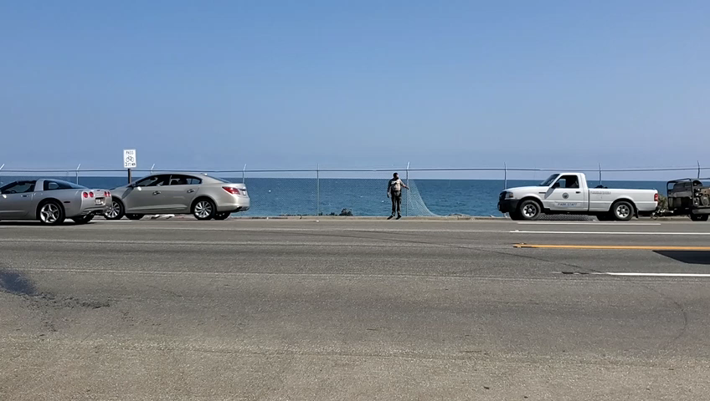
MRCA Removes unpermitted fence
Notes:
Here you can see the MRCA's staff diligently removing the unpermitted fence that spanned both public beach parcels. That is, the new fence was added inside the eastern dedicated parcel's existing fence to essentially double the fencing there. MRCA's staff took additional precautions to dismantle the fence without damage to any of the removed fencing materials and stored the removed fencing at King Gillette Ranch. The neighbors were advised that they may retrieve their removed fencing materials.

Slide 8
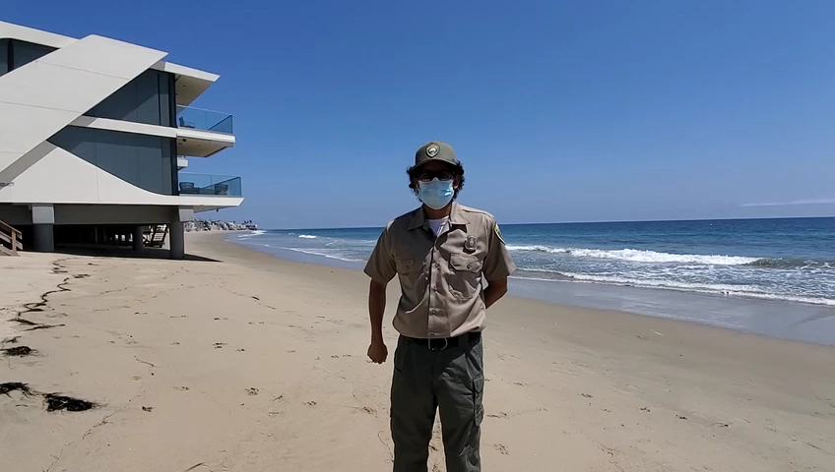
Edgar del campo
Notes:
As part of the MRCA's operations team, Mr. Del Campo wishes to express to you his dedication to protecting public property.

Slide 9
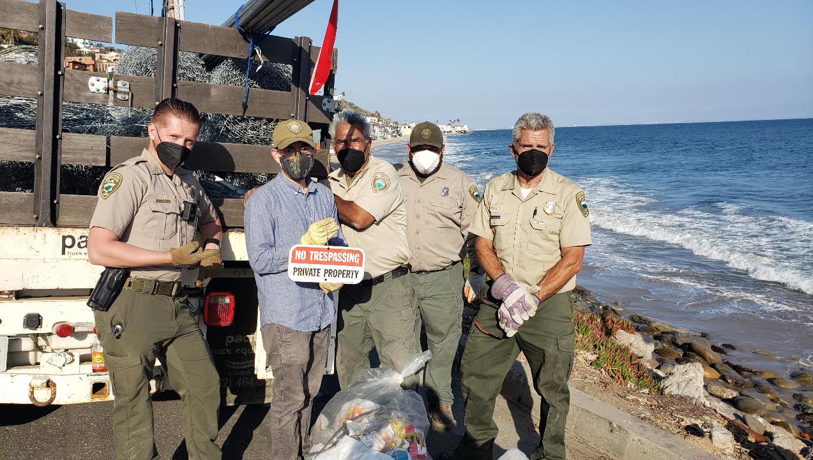
MRCA Staff Removes 350+ ft of Unpermitted Fencing, Barbed Wire and
"No Trespassing Private Property" Sign Installed by Neighbors
Notes:
The MRCA is proud to be stewards of public coastal property. Here is our staff last Friday.

Slide 10
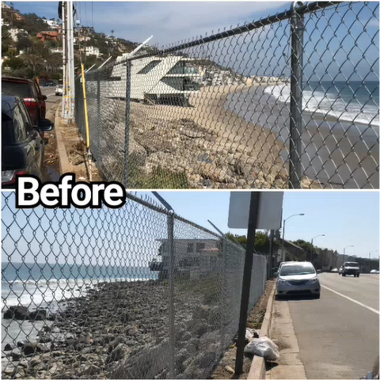
Notes:
On May 8, the MRCA posted this video on social media. On Instagram, it received over 3,800 views to date and 59 comments, all but one thanking the MRCA for its public stewardship.
We are happy to answer any questions.

