Slide 1
Harassment of public employees at carbon-la costa beach
Mountains Recreation and Conservation Authority
June 9, 2021

Slide 2
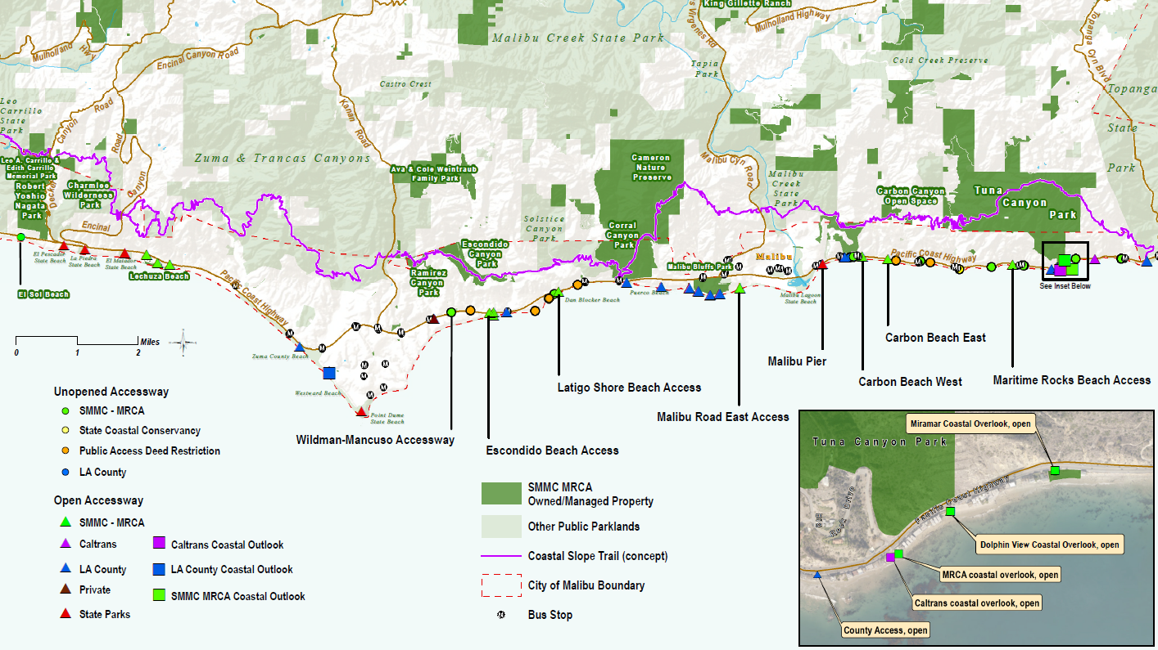
Carbon – La Costa Beach

Slide 3
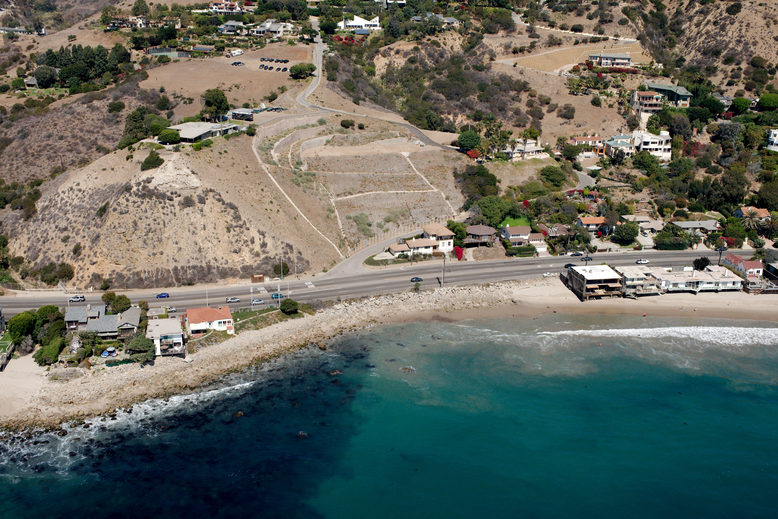
Carbon – la costa public beach

Slide 4
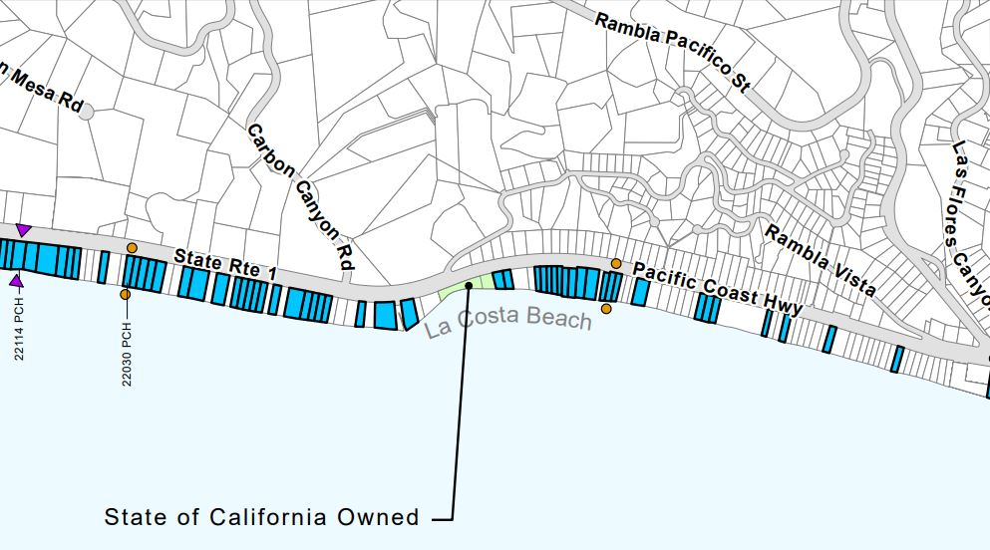
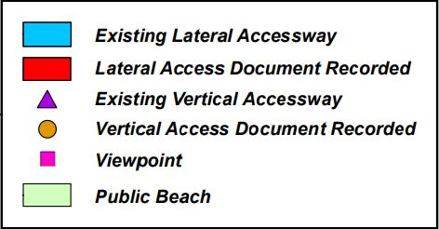
City of Malibu lcp public access map – la costa public beach

Slide 5
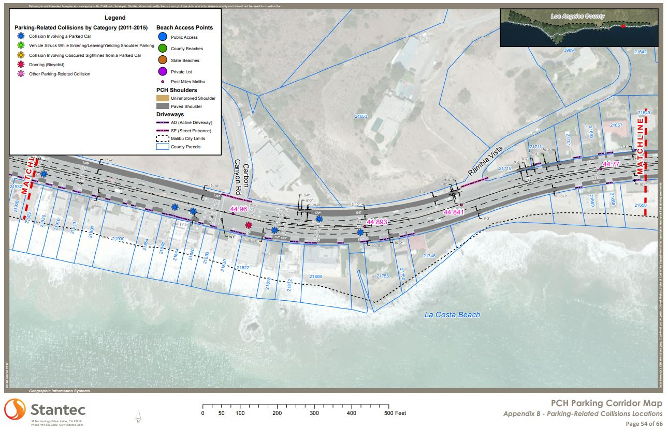
Pacific coast highway parking study

Slide 6
Sheriff calls 2020-2021
No Traffic Accidents, No Injuries, All Calls are complaints about people on beach
2020
August 2 at 17:05
August 3 at 09:24
August 22 at 22:38
September 6 at 15:19
September 6 at 16:22
2021
May 24 at 22:52
May 29 at 17:14

Slide 7
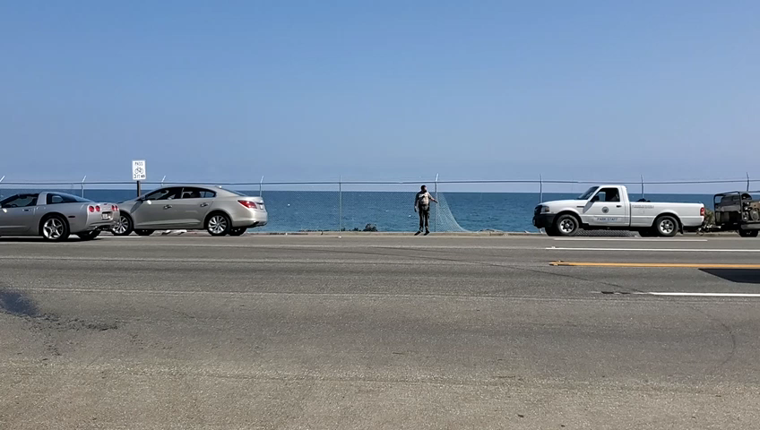
MRCA Removes unpermitted fence: May 7-8, 2021

Slide 8
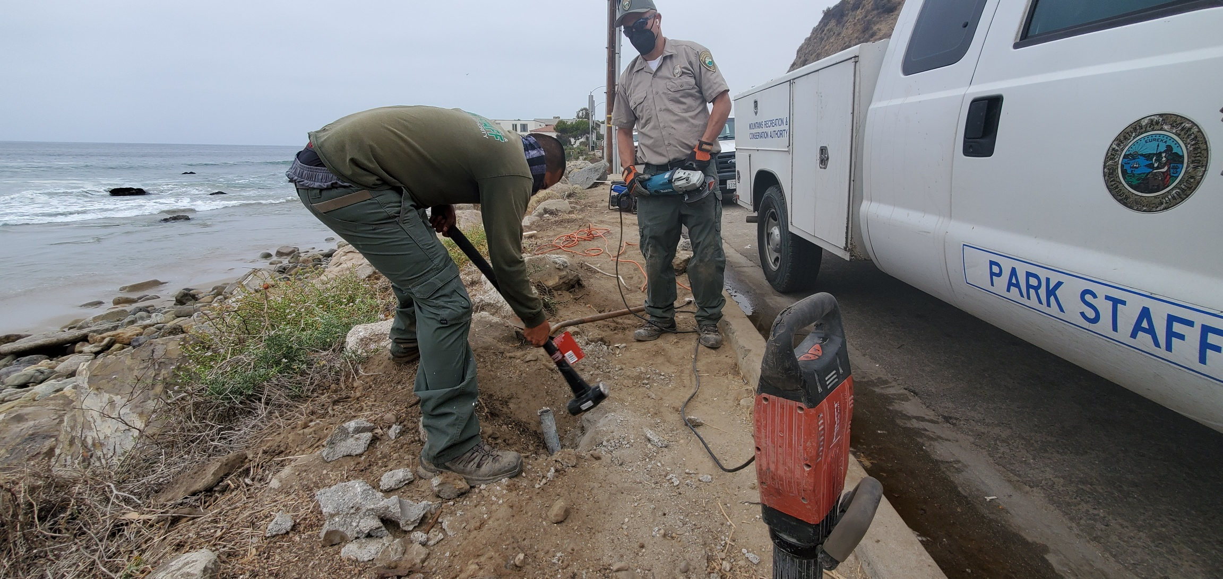
MRCA Removes remainder of unpermitted fence: June 3, 2021

Slide 9
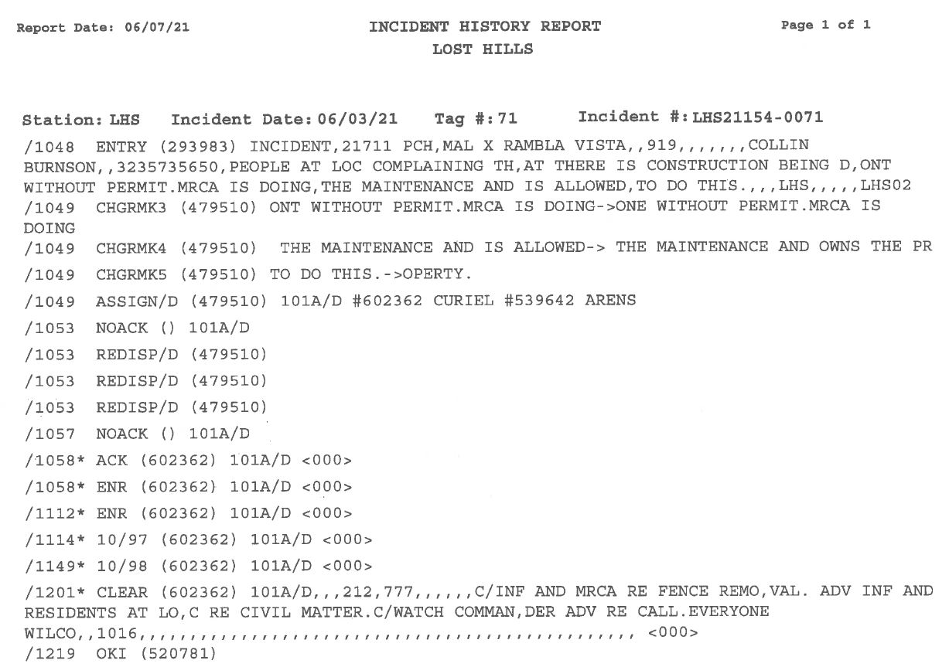
Residents call Sheriff on mrca maintenance staff: June 3, 2021

Slide 10
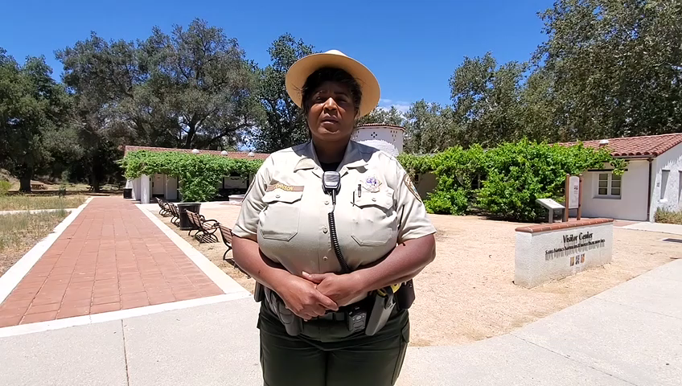
Supervising rAnger – Jewel Johnson

Slide 11
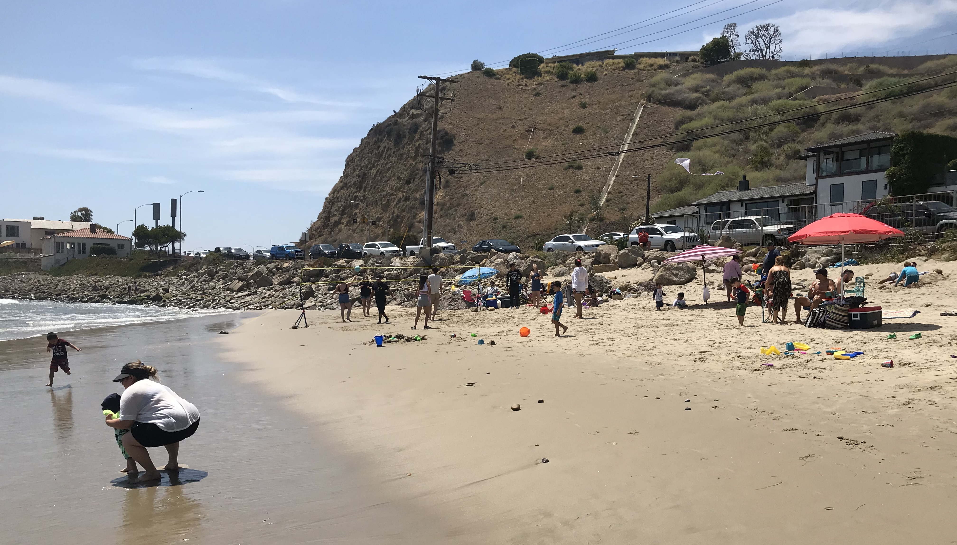
Carbon – la costa beach: june 5, 2021
MRCA Coastal Access Program
mrca.ca.gov/coastal-access/

