Slide 1
unpermitted fence removed from carbon-la costa beach
Mountains Recreation and Conservation Authority
May 12, 2021

Slide 2
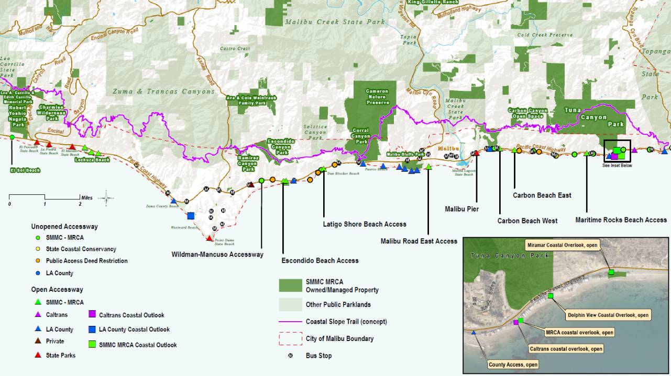
Carbon – La Costa Beach

Slide 3
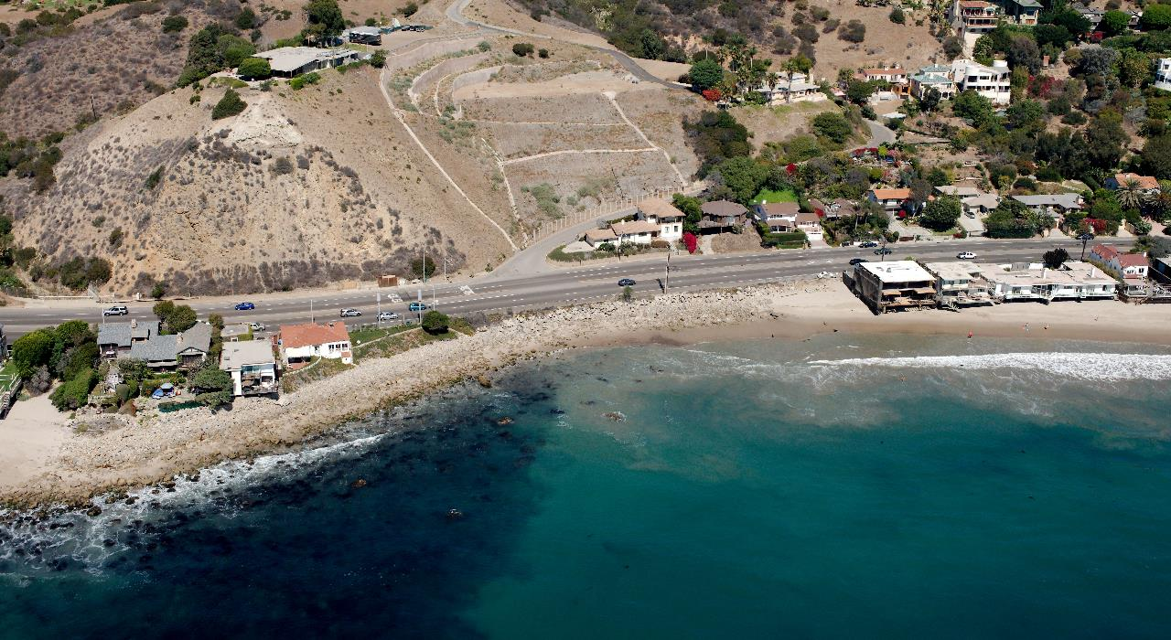
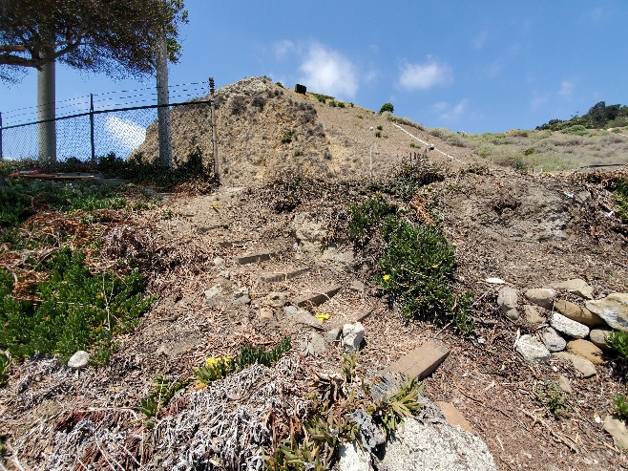
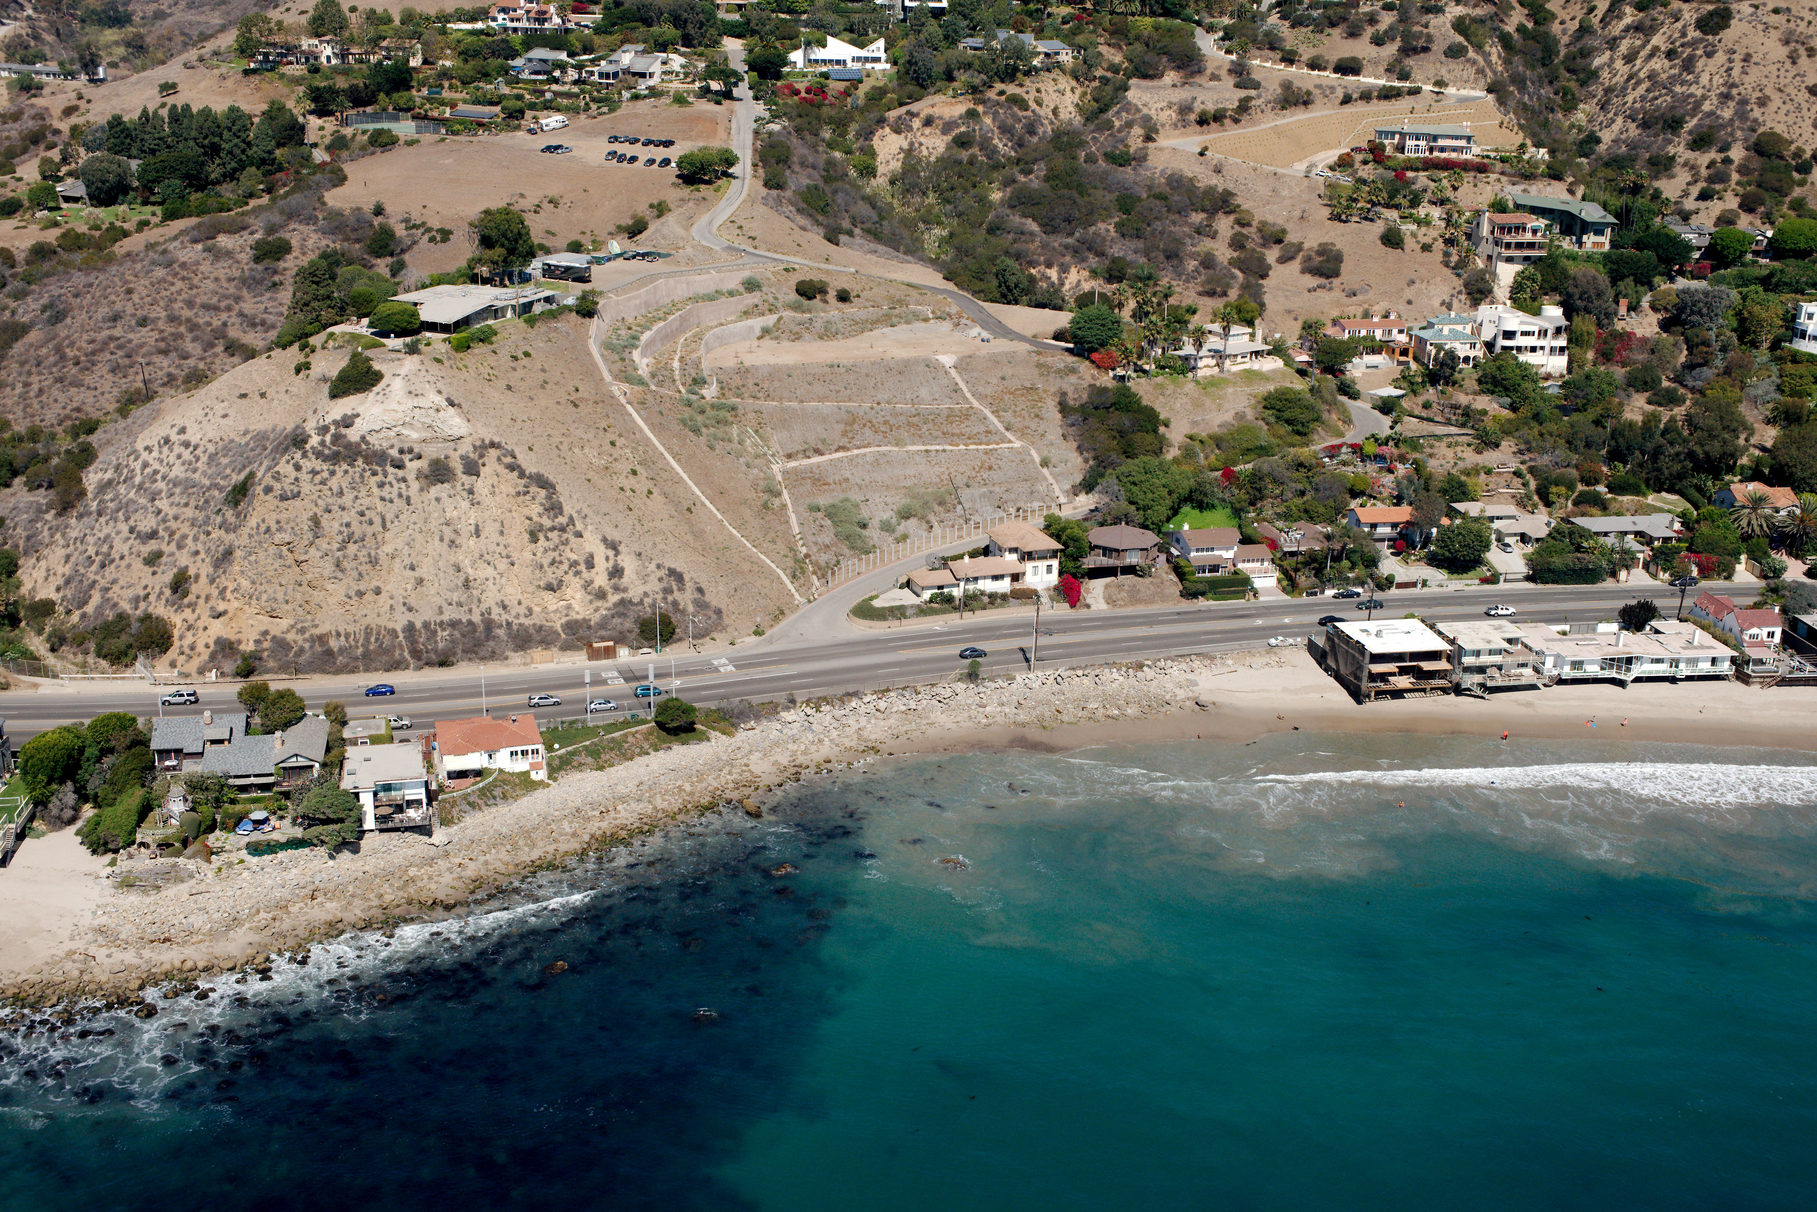
Carbon – la costa public acquisition

Slide 4
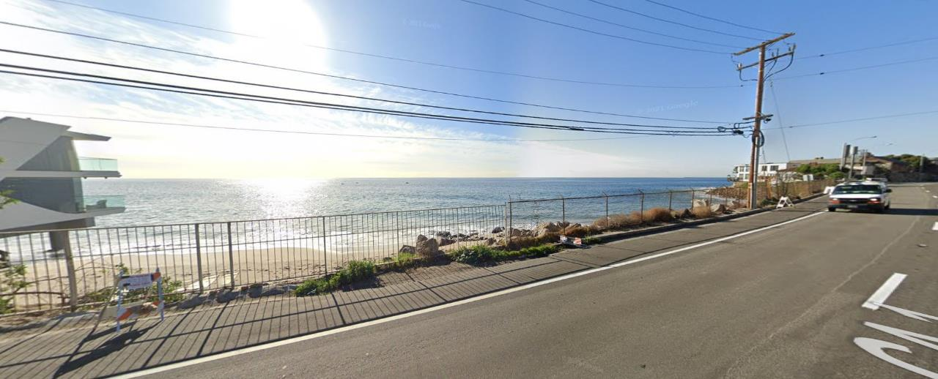
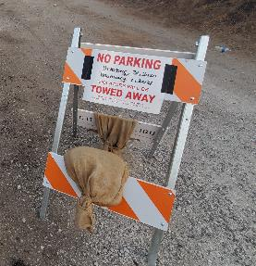
Carbon – la costa beach previous fence
Google Street View (Image date: December 2020)

Slide 5
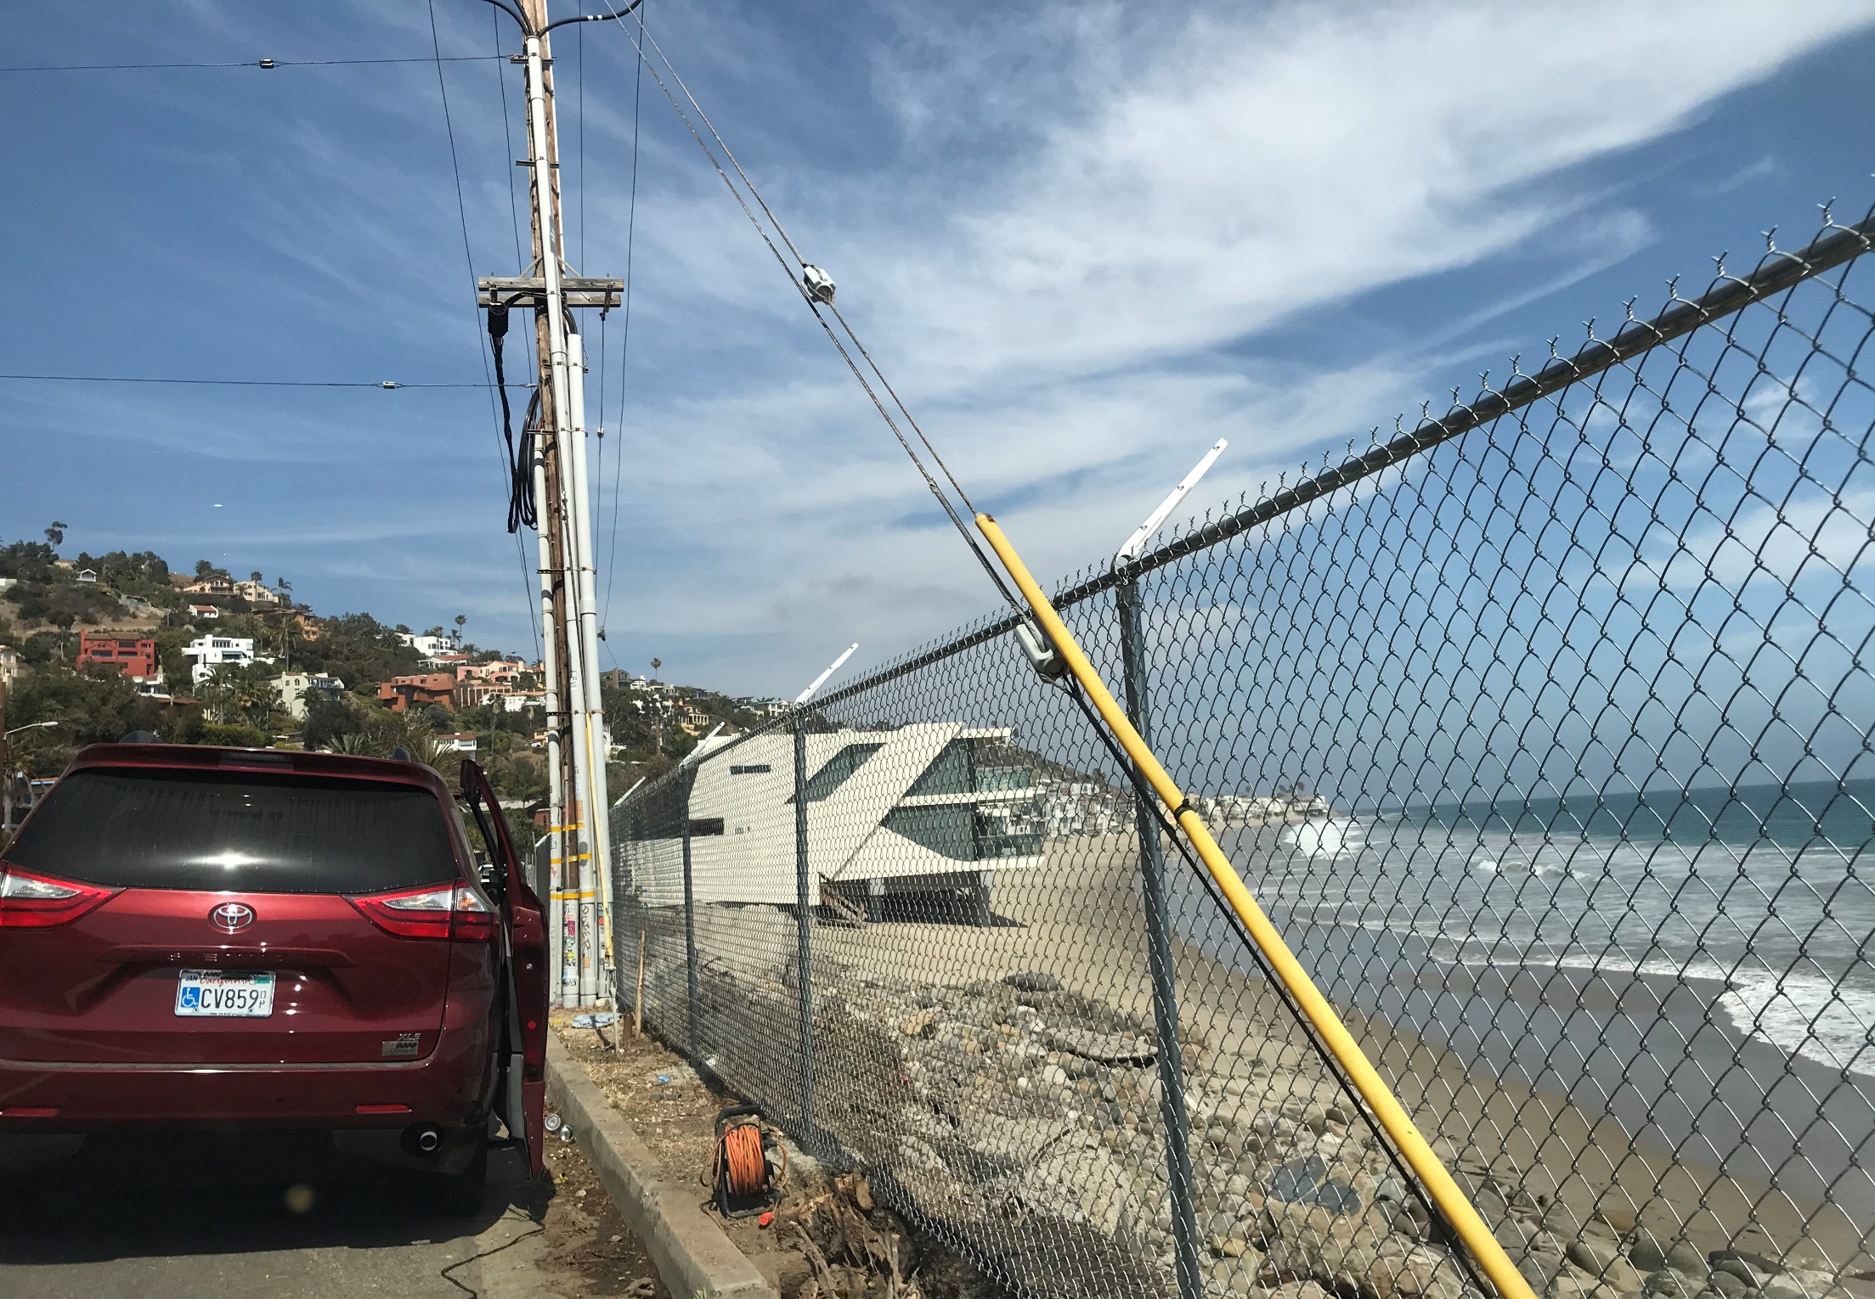
Carbon-La Costa Beach offers important coastal access

Slide 6
Neighbor Communication chronology
August 3, 2020 – Doug Rogers (eastern residential neighbor) emails City of Malibu about the aesthetic condition of and a hole in the fence. City forwards complaint to Coastal Commission staff; CCC staff forwards to MRCA.
August 6, 2020 - MRCA emails Rogers of August 4th fence repair and requests Rogers contact MRCA Ranger Services/LA County Sheriff to report future incidents.
August 6, 2020 - Rogers emails City complaining about MRCA's repair work.
September 8, 2020 - Rogers emails CCC staff that fence damaged during Labor Day; 100s of people on beach; neighbors repair fence; and suggests "fence with spikes at the top" to keep people out.
September 8, 2020 - MRCA emails Rogers re fence repairs ASAP; advises CDP needed for replacement fence; and reiterates Rogers/neighbors contact MRCA Ranger Services/LA County Sheriff in lieu of "self-help."
May 5, 2021 – MRCA observes old fence removed; new fence under construction; asks contractor crew about permits, landowner permission and contractor's employer.
May 7, 2021 - MRCA Rangers interview contractor who calls employer (neighbors); neighbors admit removing old fence and building new fence alleging City permission and refuse to remove new fence. MRCA removes unpermitted new fence.

Slide 7
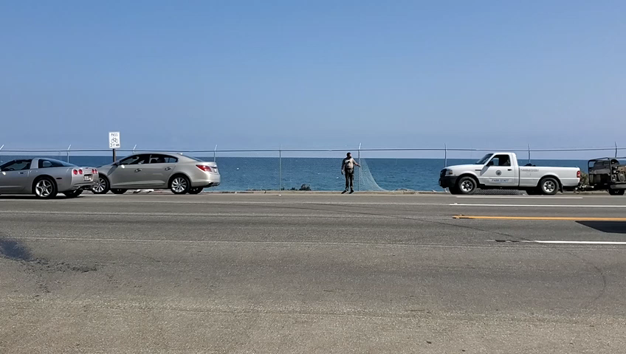
MRCA Removes unpermitted fence

Slide 8
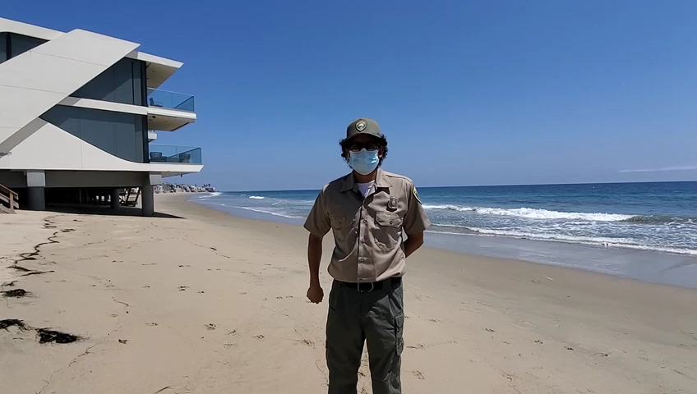
Edgar del campo

Slide 9
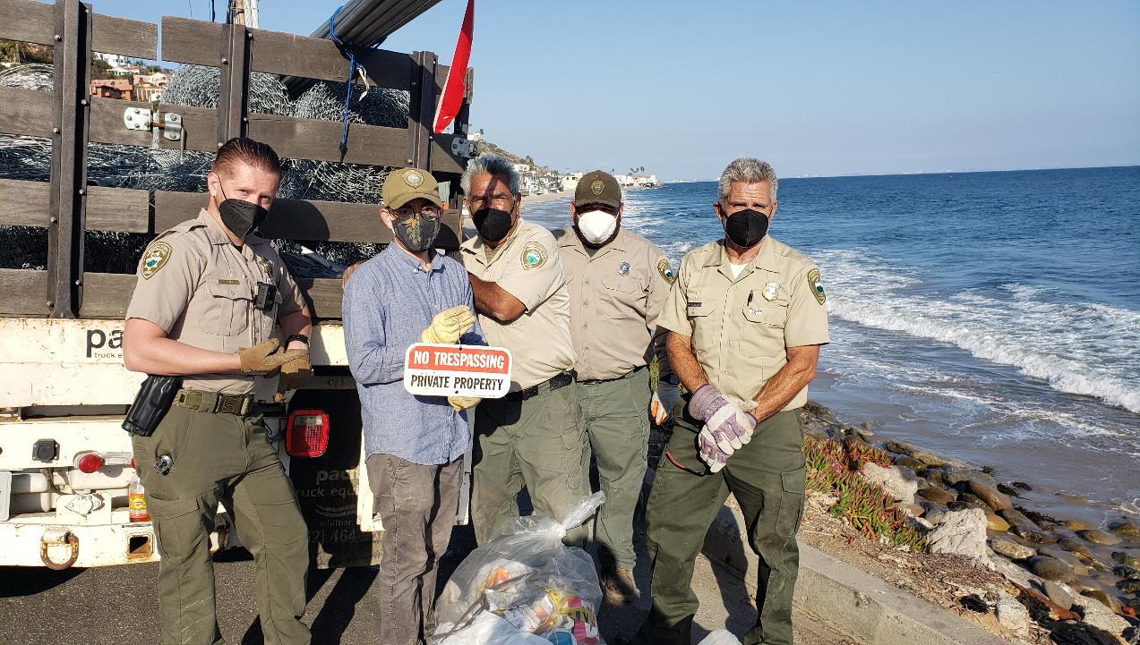
MRCA Staff Removes 350+ ft of Unpermitted Fencing, Barbed Wire and
"No Trespassing Private Property" Sign Installed by Neighbors

Slide 10
